Slide 1
Envisioning Session

Slide 2
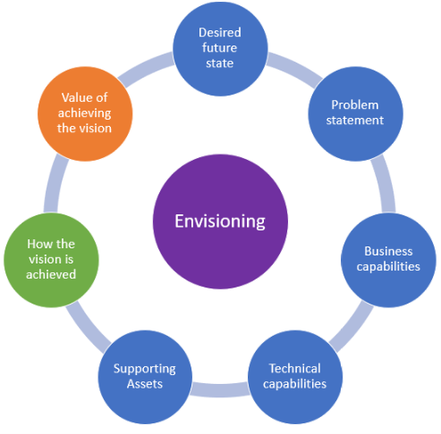
Deliver an Envisioning Session
An envisioning session is a common agile methodology practice that is particularly important for AI engagements as it is up to the partner to help the customer realize the opportunities for AI in the customer’s problem statement.
The benefits of conducting an envisioning session are to:
Answer fundamental business questions of what you will build, and a general sense of how.
Improve productivity on the project having identified and thought through the critical business issues facing the project.
Identify the overall business direction required by your architecture.
At the end of the envisioning session:
The customer will have a vision of how your AI practice can help their organization realize their goals and drive business impact.
You will have sufficient knowledge to write a proposal for an engagement.
You may identify additional opportunities to apply AI to the customer’s scenarios for future engagements.

Slide 3

Envisioning Checklist
Allow ~4 hours
Work with your customer to brainstorm the solution approach, based on details captured from the discovery and ideation sessions.
Be sure to do the following:
Key functionalities and capabilities of the solution to meet functional requirements and goals
Components of the solution (e.g. which app services, data services, client side software, identity services, etc.)
Security considerations (TLS, identity, authorization, etc.)
Compliance considerations (HIPAA, PCI, etc.)
Identify external connections and integration points (APIs, business intelligence)
Map requirements and scenarios to the proposed solution components

